Slide 1

Institute for International Law and Comparative Constitutional Law
European Law Moot Court
  Academic Year 2025/2026

Slide 2
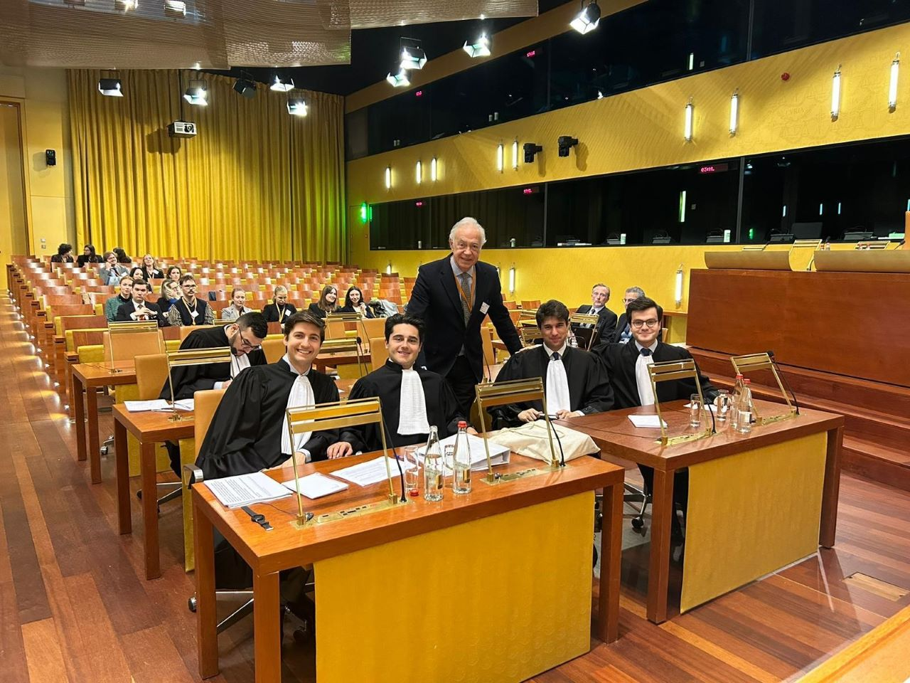
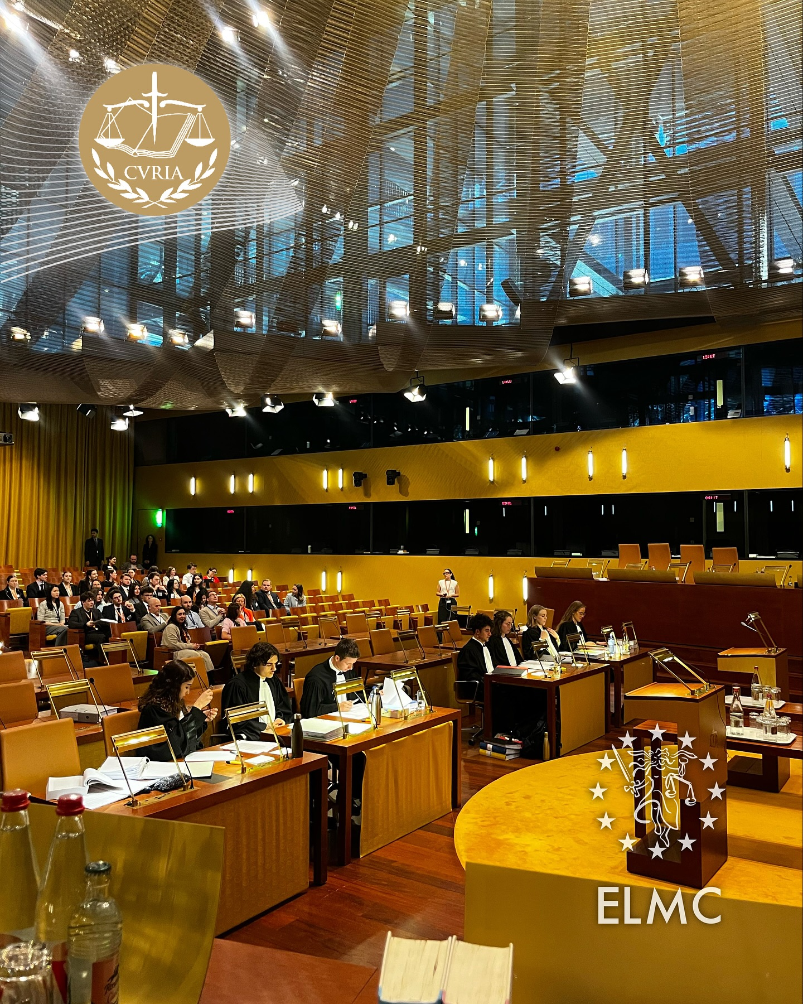
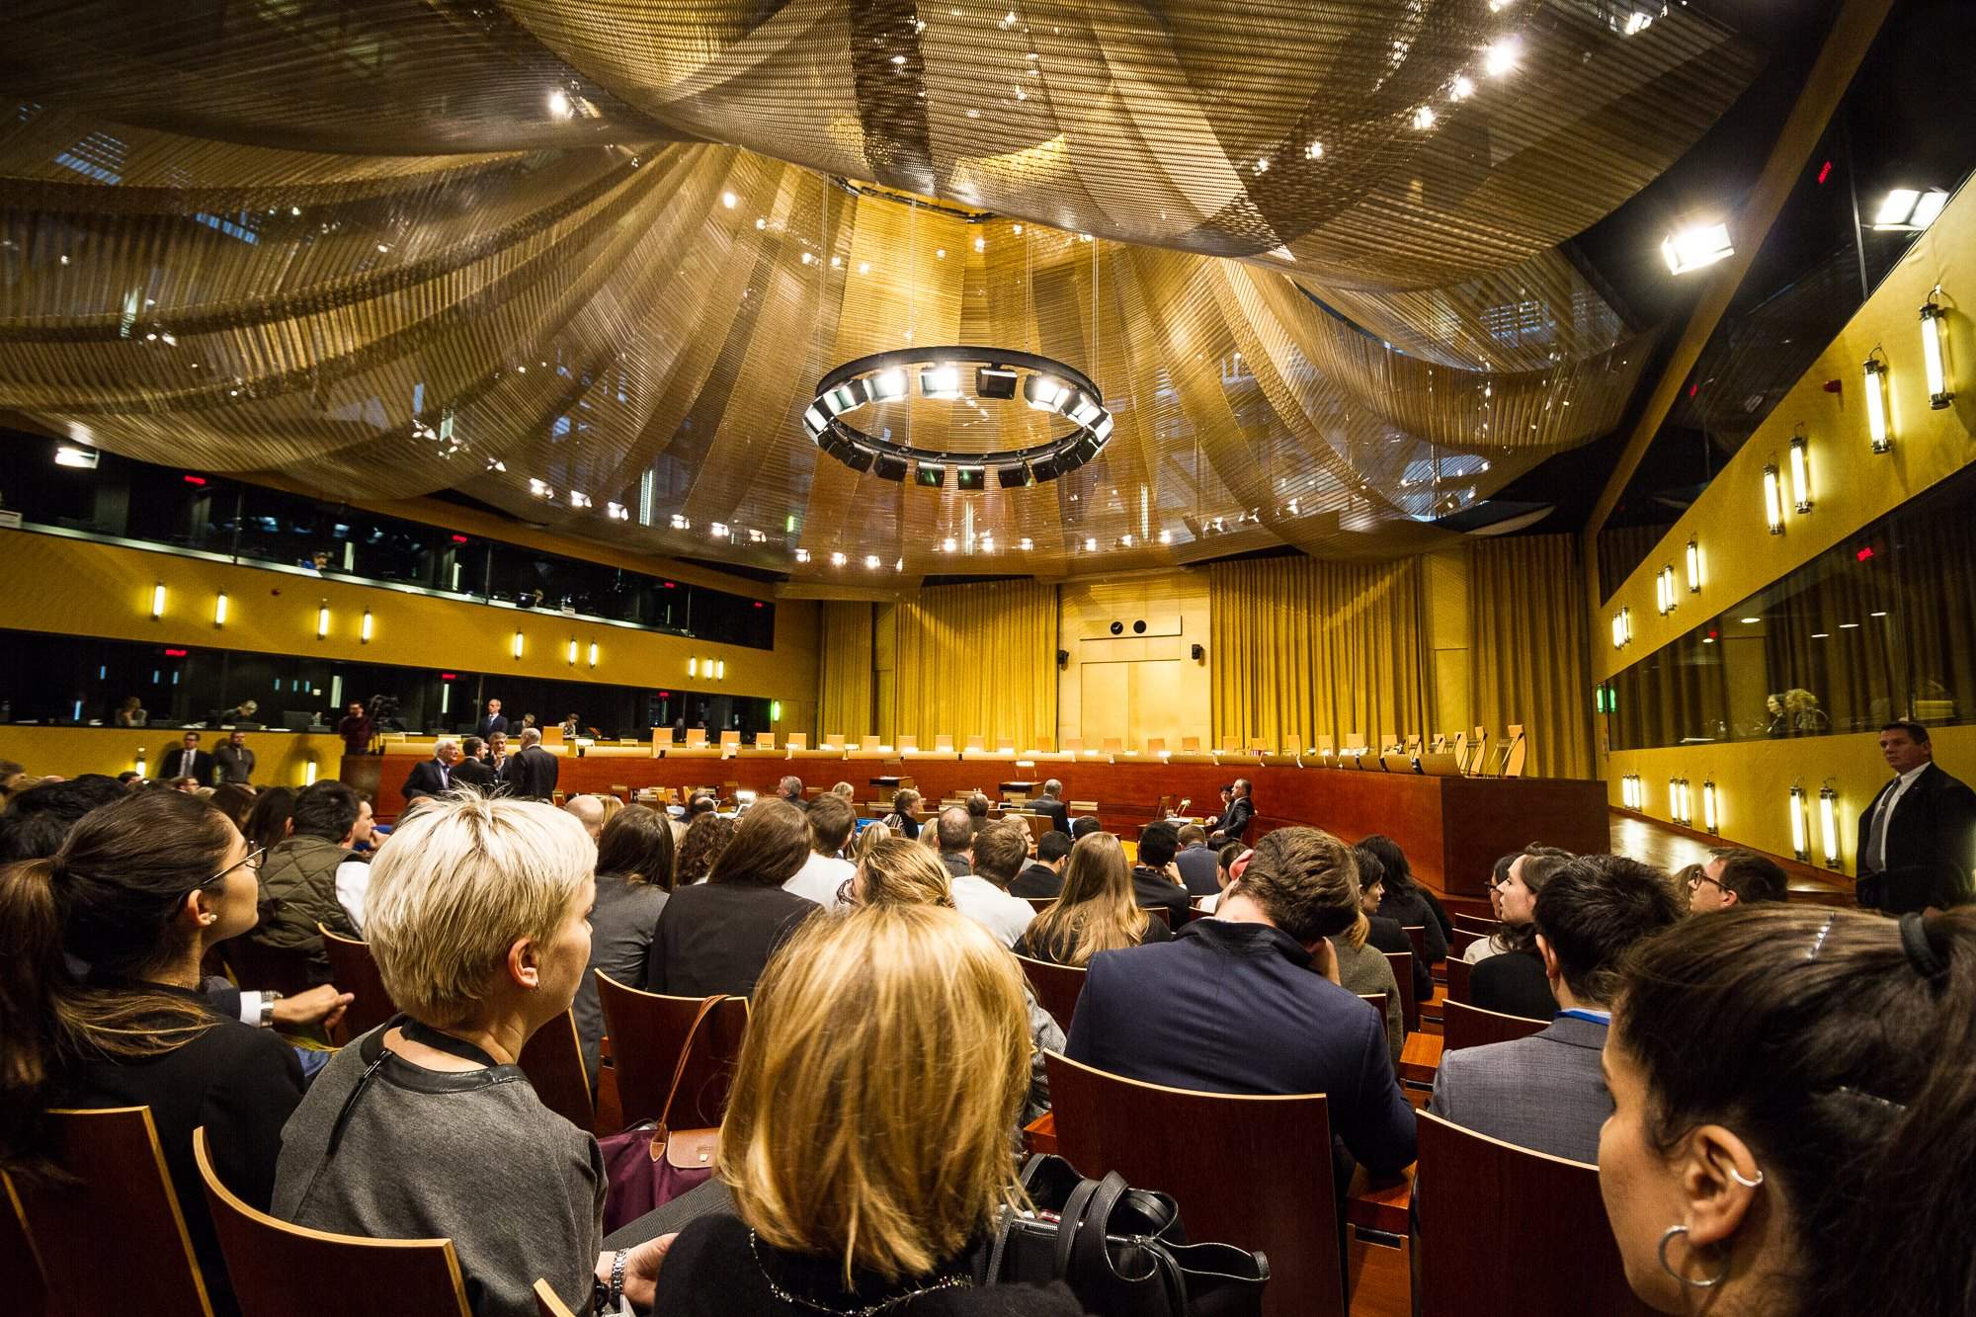
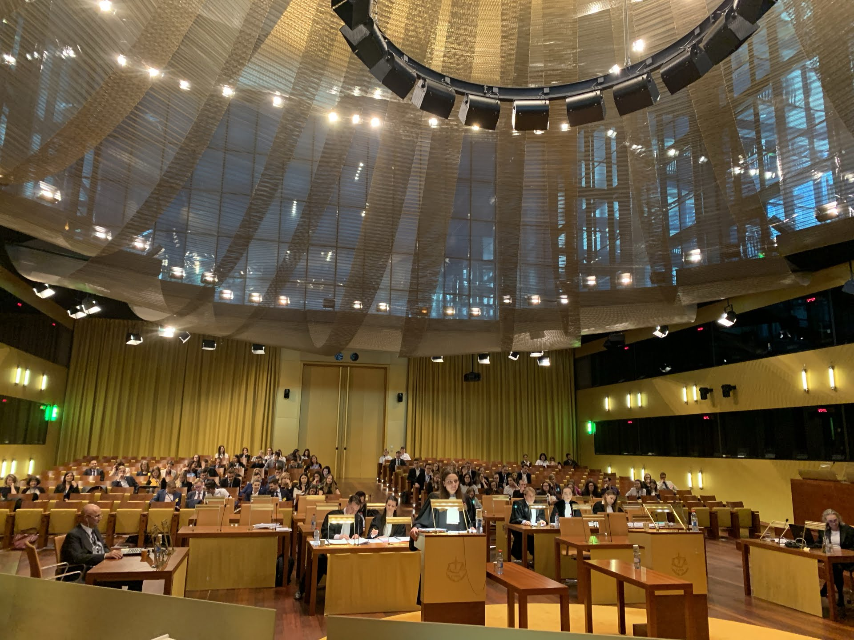
What is the European Law Moot Court?
  First-ever UZH participation in Fall Semester 2025
  Largest and most prestigious moot court in European Union law
  Teams from over 100 universities across Europe and worldwide compete annually
  Simulates real proceedings before the Court of Justice of the EU
  The teams prepare and analyze a hypothetical EU law problem
  Practical case typically addresses cutting-edge issues in EU institutional law, competition law, and single market law
  Judged by practicing EU lawyers, academics, and sometimes sitting judges from EU courts
  Alumni often pursue careers at EU institutions, international law firms, and academia

Slide 3
Switzerland and EU law
  Despite not being an EU member, Switzerland is deeply integrated with the European Union
    Over 120 bilateral agreements govern Switzerland-EU relations
    Switzerland voluntarily adopts EU legislation (“autonomer Nachvollzug”)
    Many Swiss laws are drafted to maintain compatibility with EU regulations
    Swiss Federal Supreme Court frequently considers EU case law in its decisions
  Knowledge of EU law essential for legal practice in Switzerland, especially in:
    Competition law
    Intellectual property law
    Financial services
    Data protection
    Trade regulations
  Growing demand for Swiss lawyers with EU law expertise in law firms and state institutions
    EU law competence significantly enhances employability in big Swiss law firms
    Participation in ELMC provides specialized EU law training relevant to Swiss legal practice

Slide 4
Notable Cases from Previous Years
  Recent cases:
    2023/2024: Foreign subsidies; Court of Justice jurisdictional questions
    2022/2023: Relationship between national and EU law; fundamental rights conflicts
    2020/2021: Competition law (abuse of market dominance); fundamental rights; asylum law; data protection law
    2017/2018: Public procurement; EU sanctions; data protection law
    2016/2017: EU monetary law and policy
    2006/2007: Competition law intersecting with international sports law
  Recurring topics:
    Fundamental Rights
    Jurisdictional Questions
    Competition Law
    Internal Market Freedoms
    Digital governance

Slide 5
Format and Timeline
What is the competition format?
  Phase 1: Written submissions (both applicant and defendant perspectives)
  Phase 2: Regional rounds (oral pleadings) in various European cities (upon qualification)
    The teams defend their arguments
    Pleading as:
      Applicant
      Defendant
      Advocate General or Commission Agent
  Final Round: European Court of Justice in Luxembourg
    The winning teams compete before the judges of the Court of Justice of the EU
  Bilingual competition (English & French)
When does it take place?
  Information Event: May 21, 2025
  Application Deadline: August 17, 2025
  Team Selection (3 or 4 students): Second half of August 2025
  Case Publication: September 1, 2025
  Written Submission Deadline: November 30, 2025
  Regional rounds in a European city: February 2026
  Final Round in Luxembourg: April 2026

Slide 6
Requirements and Benefits
Who can participate?
  Open to Master students in law in the next two semesters (HS 25 and FS 26)
  Strong interest in EU law, competition law, and single market law
  Good English proficiency required
  French knowledge is an advantage
  Profound EU law knowledge desirable but not mandatory
  Willingness to work closely in a team with other students over a full academic year
Why should I participate in the moot court?
  Develop advanced legal research, writing, and oral advocacy skills
  Networking with leading experts and peers from across Europe
  Opportunity to engage with complex, contemporary EU legal issues
  Gain in-depth knowledge of EU law (which is highly important for future lawyers practicing in Switzerland)
  Develop your ability to collaborate effectively in a team
  First step toward building an international legal career with European focus
  Receive 12 ECTS for the written phase (which may form your master’s thesis)
  Additional 6 ECTS upon qualification for Regional Finals
  Total potential: 18 ECTS

Slide 7
Application Process
  Requirements:
    CV (in English)
    Letter of Motivation (in English) should include following relevant information
      Language Proficiency: Indicate your level of English (required) and French (advantage)
      EU Law Experience: Describe your knowledge of EU law (courses taken, projects, internships)
      Current Status: Specify your current semester and program
      Enrollment Information: Confirm whether you're enrolled at UZH only or part of a double degree program
    Transcript of Records
  Key Information:
    Deadline: August 18, 2024
    Submit to: lst.oesch@ius.uzh.ch

Slide 8
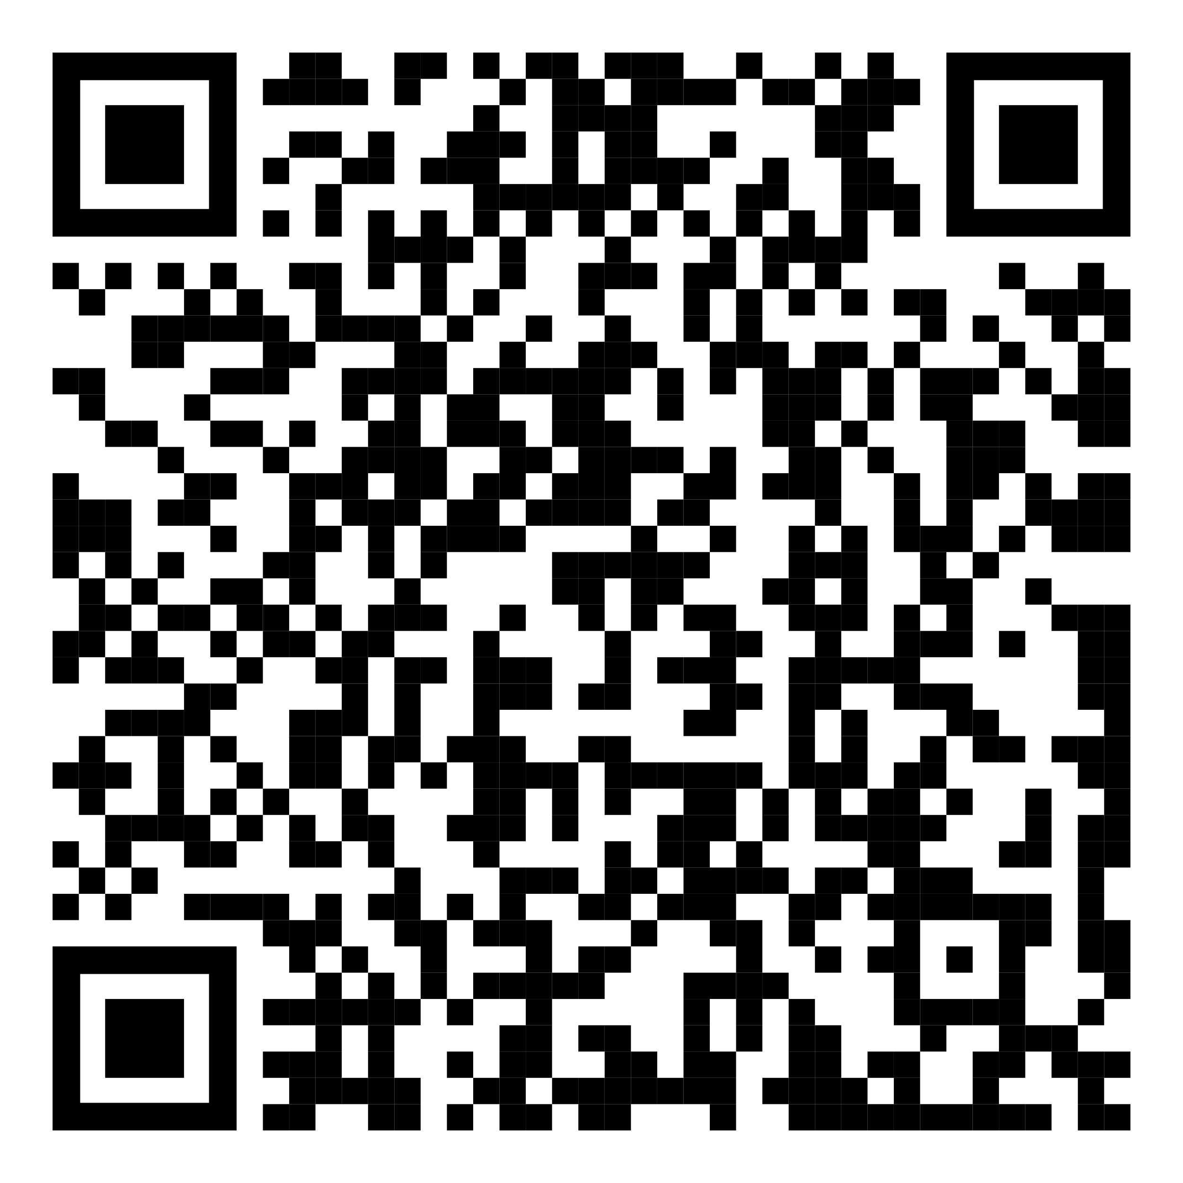
Contacts for questions
johannes.rohrmann@ius.uzh.ch
alexandru.badea@ius.uzh.ch

